Slide 1

PERSONAL BUDGET
Welcome! This presentation will guide you through the principles of personal budgeting and how it can help you achieve financial stability. From understanding your income and expenses to creating a balanced budget and developing strategies for saving and debt reduction, we'll cover it all. Let's embark on a journey to financial well-being!
1

Slide 2
Why Budgeting Matters
Control Your Finances
Achieve Financial Goals
Reduce Stress and Anxiety
Build a Strong Financial Future
Take charge of your money by understanding where it goes. Budgeting empowers you to make informed financial decisions.
Budgeting helps you set and achieve your financial goals, such as buying a house, paying off debt, or saving for retirement.
Financial uncertainty can be stressful. Budgeting helps eliminate financial worries and provides peace of mind.
Budgeting is the foundation for financial security. By managing your finances effectively, you set yourself up for a brighter future.
2

Slide 3

Identifying Your Income and Expenses
Income
Expenses
List all sources of income, including salary, investments, or side gigs.
Track all your spending, from essential bills to discretionary purchases.
3

Slide 4

Categorizing Your Expenses
Housing
Transportation
Rent, mortgage, property taxes, insurance, utilities.
Car payments, gas, public transportation, car insurance, maintenance.
Food
Healthcare
Groceries, dining out, takeout, snacks.
Health insurance, doctor's visits, prescriptions, dental care.
4

Slide 5

Creating a Balanced Budget
1
Allocate your income to each expense category.
2
Adjust your spending habits based on your income and goals.
3
Review your budget regularly to ensure it's meeting your needs.
5

Slide 6

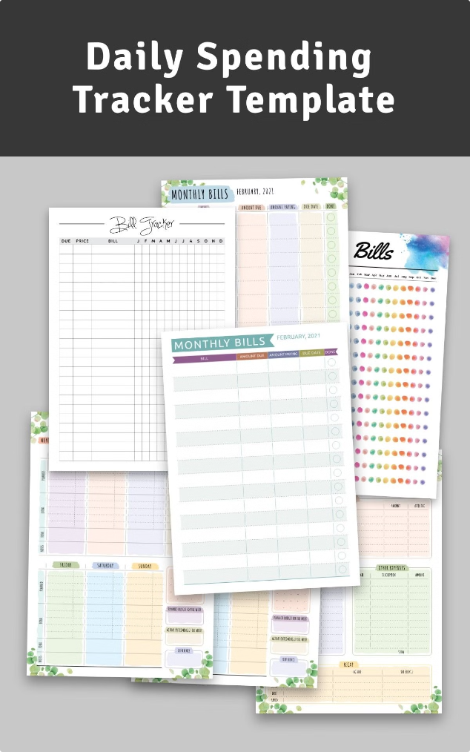



Tracking and Adjusting Your Spending
Track Spending
Use a budgeting app, spreadsheet, or notebook to monitor your spending.
Identify Overspending
Identify areas where you're spending more than you budgeted for.
Make Adjustments
Reduce unnecessary spending or increase your income to balance your budget.
6

Slide 7




Strategies for Saving and Debt Reduction
Set Savings Goals
1
Define your goals, such as emergency fund, down payment, or retirement.
Automate Savings
2
Set up automatic transfers to your savings account regularly.
Reduce Debt
3
Prioritize high-interest debt and focus on paying it down quickly.
Explore Debt Consolidation
4
Combine multiple debts into one loan with a lower interest rate.
7

Slide 8

Maintaining Your Budget and Achieving Your Financial Goals
Review Regularly
1
Periodically review your budget and adjust it as needed.
Track Progress
2
Monitor your progress toward your financial goals and celebrate milestones.
Seek Professional Advice
3
Consult a financial advisor for personalized guidance.
8

Slide 9
Thank you..!
9

